Slide 1
RSA (Rivest–Shamir–Adleman) Cryptosystem

Slide 2
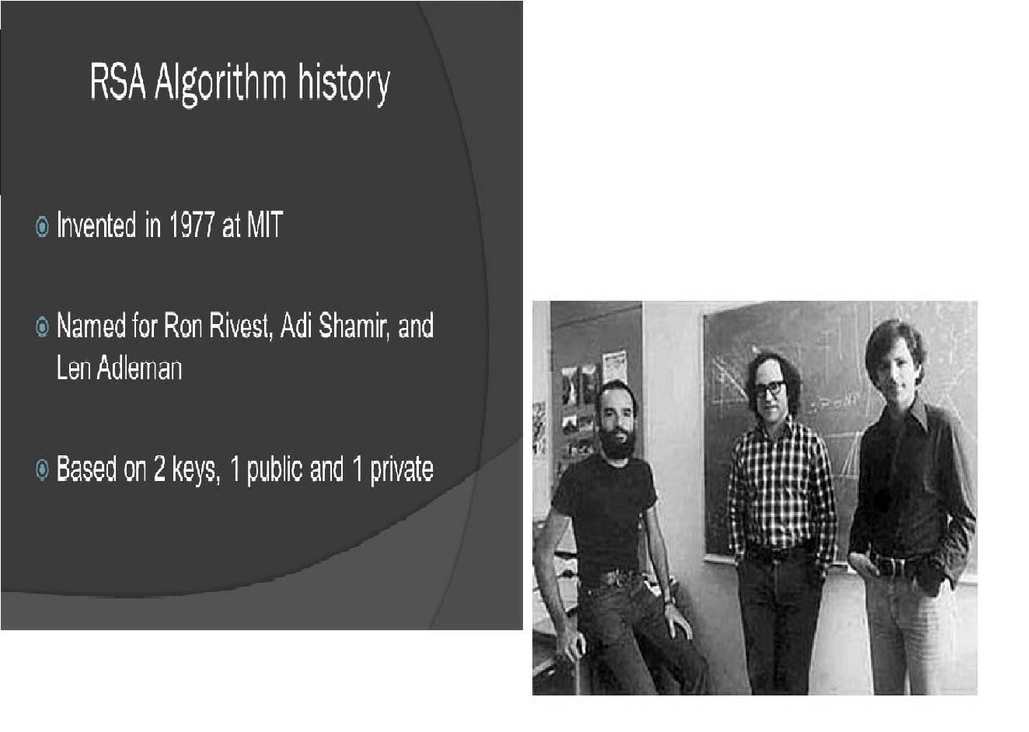

Slide 3
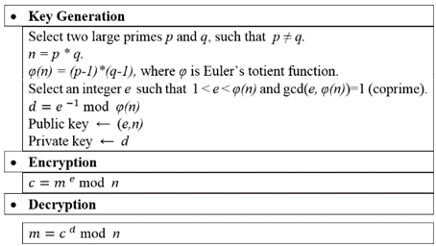

Slide 4
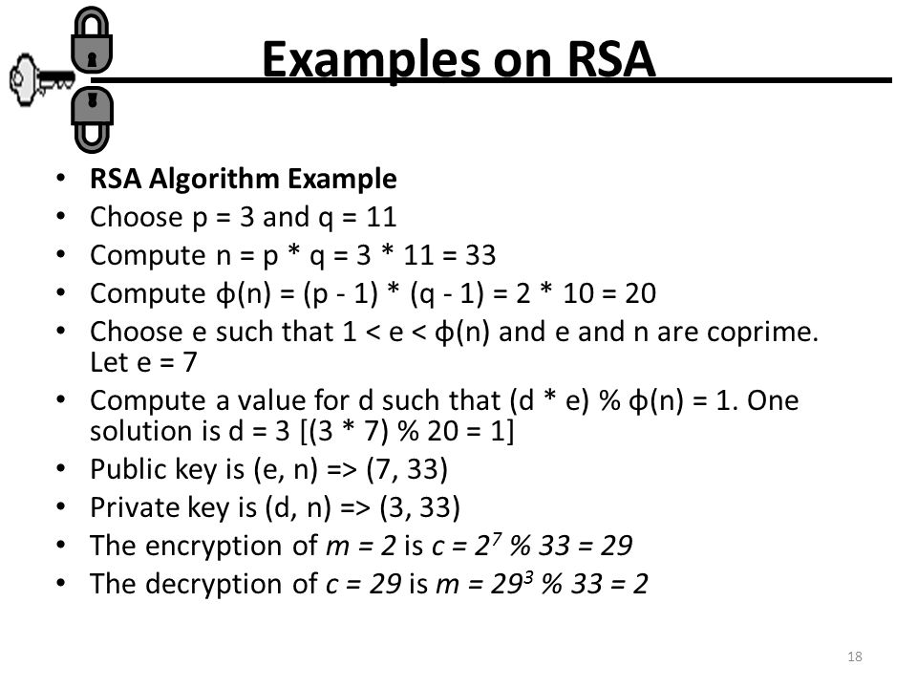

Slide 5
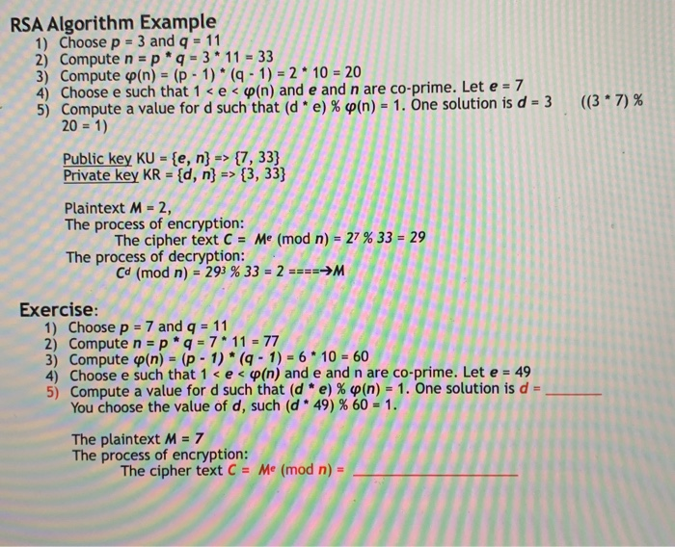

Slide 6
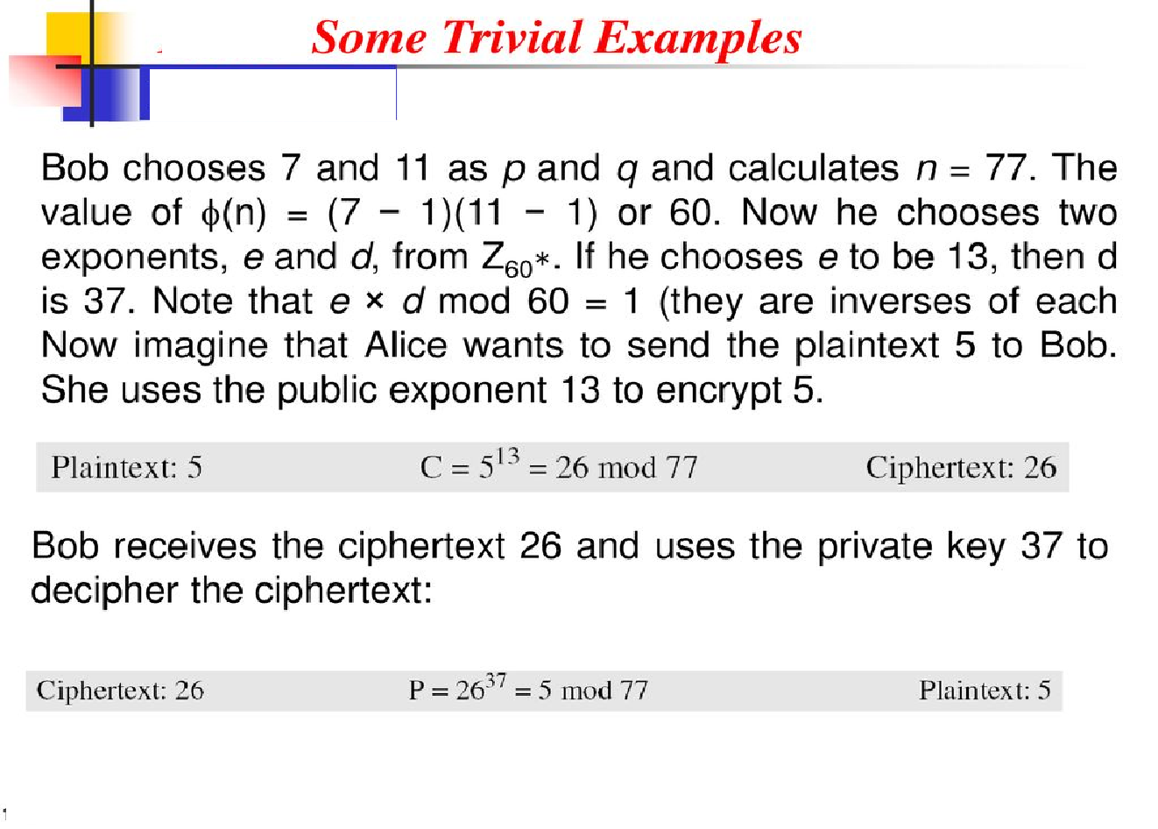

Slide 7
Another Example
p = 3 and q = 11
choose e = 3
Plaintext=4

Slide 8
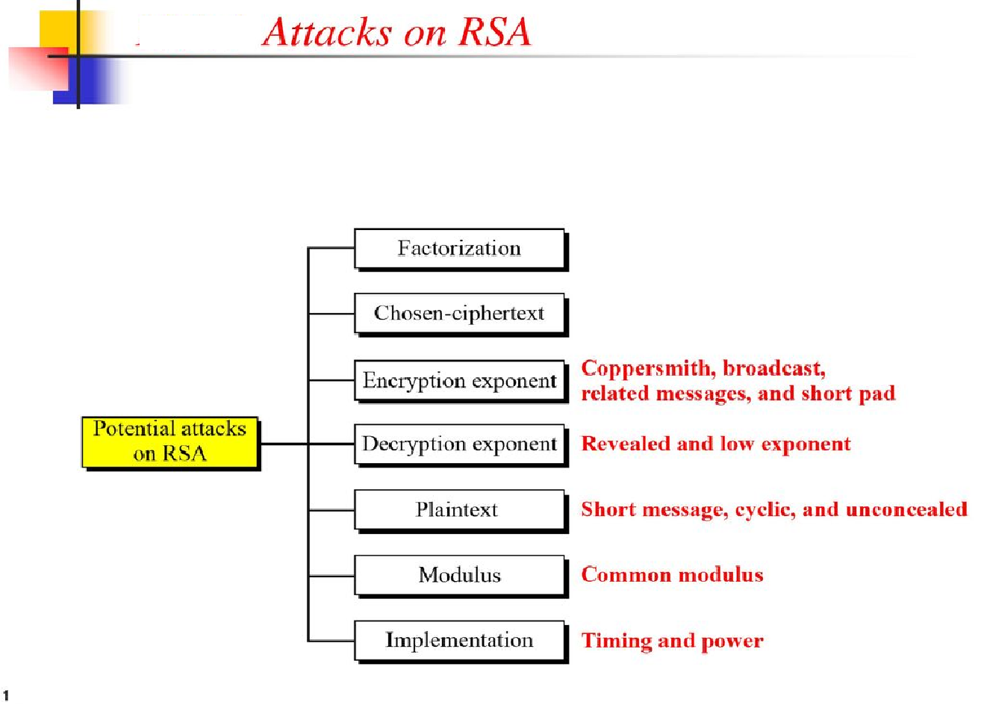

Slide 9
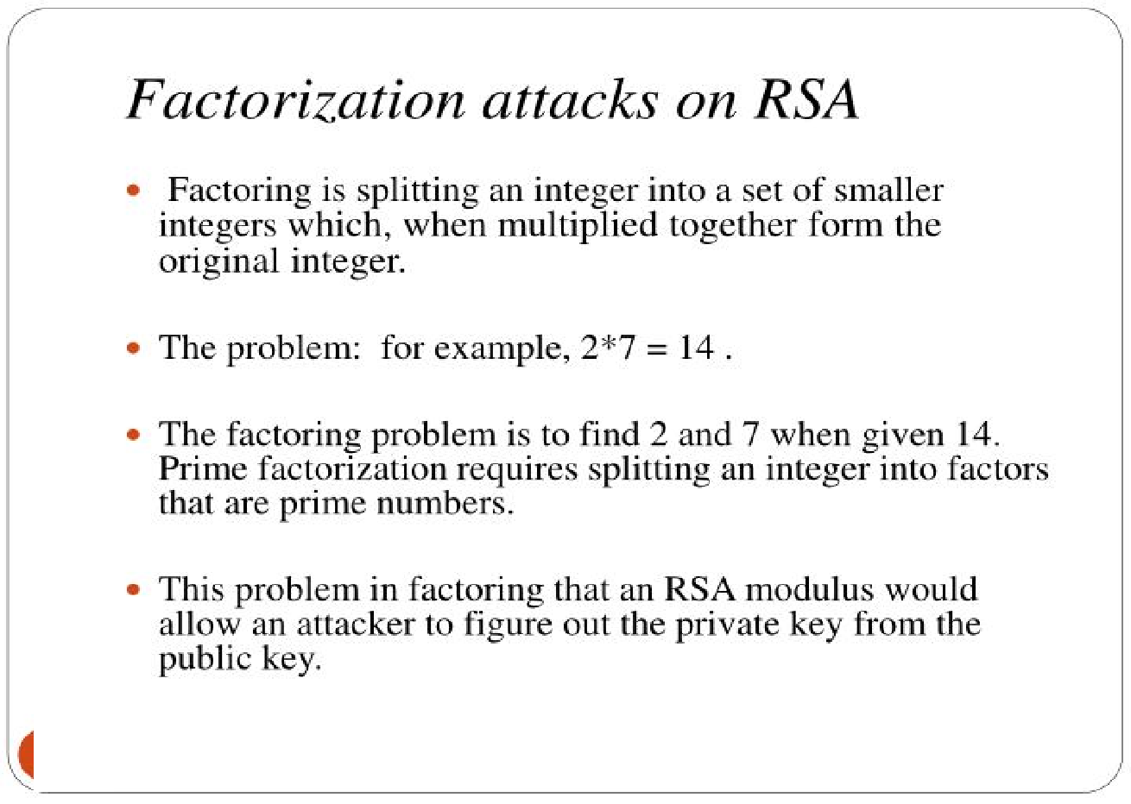

Slide 10
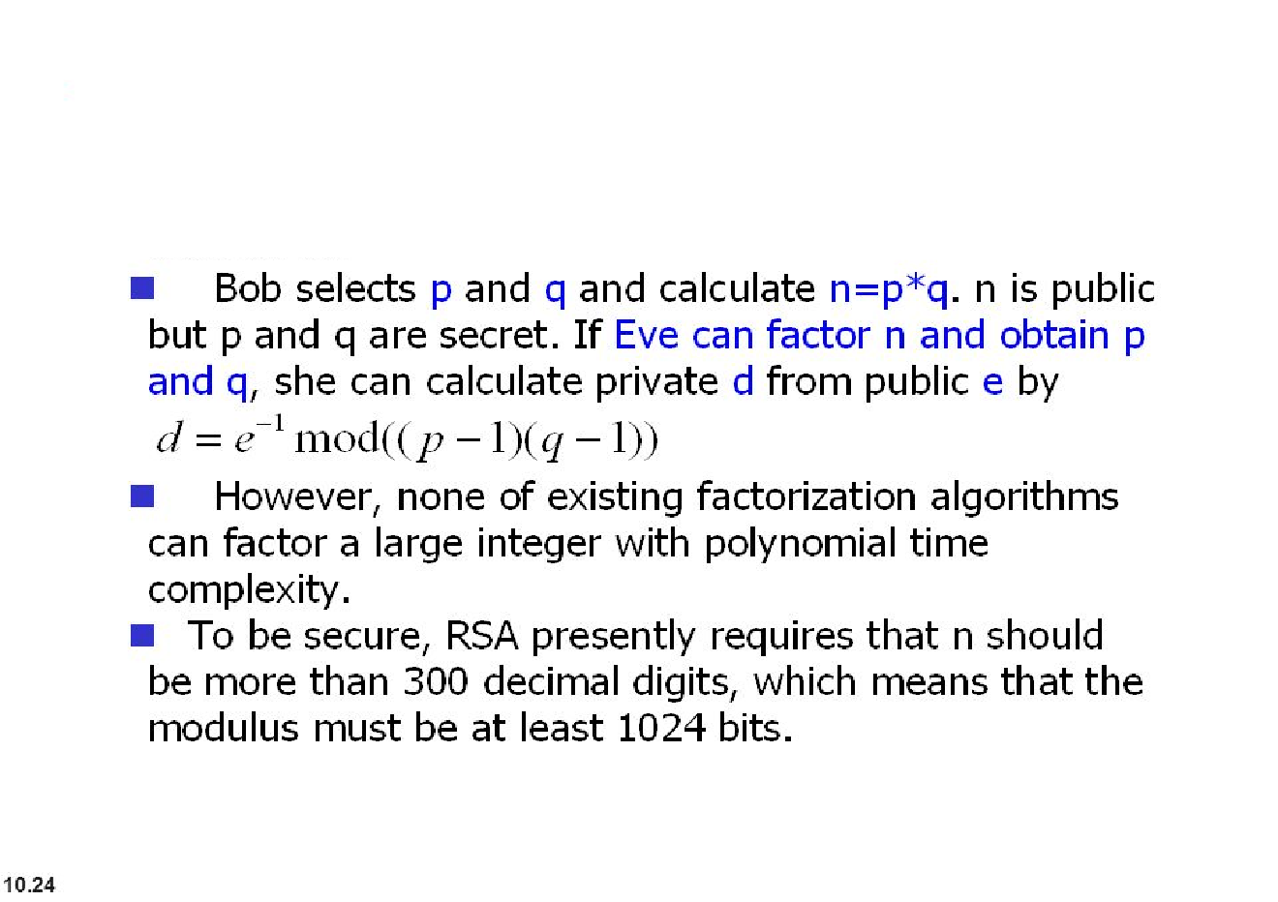

Slide 11
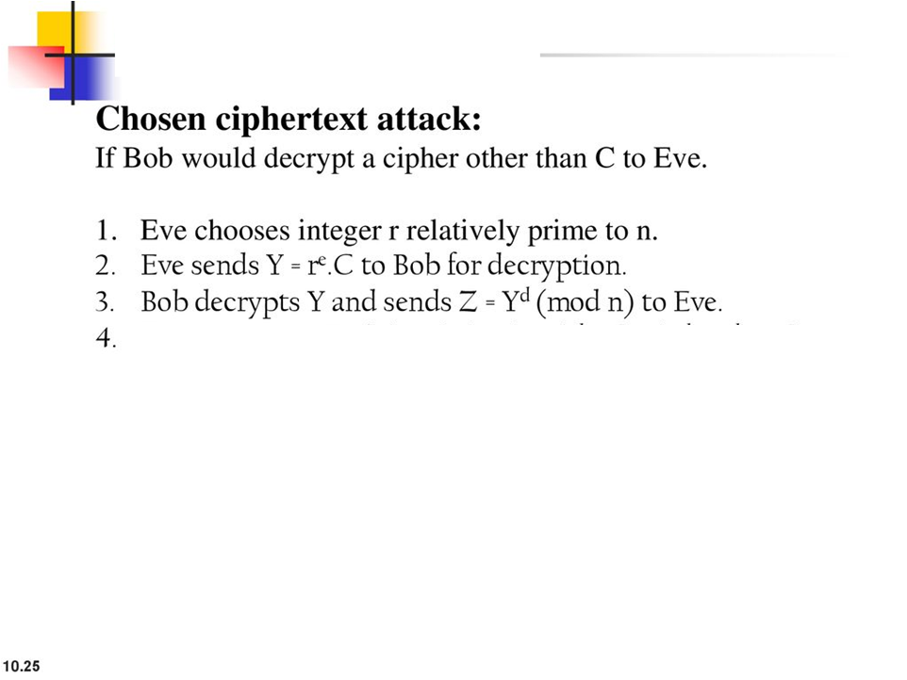
Eve can easily find out P
Z=Y^{d} (mod n) = (r^{e}. C)^{d} mod n= r^{ed}. C^{d} (mod n)= r. P (mod n)
Z=r.P (mod n)
P=r⁻¹. Z(mod n)

Slide 12
Broadcast Attack
The broadcast attack can be launched if one entity sends the same message to a group of Recipients with the same low encryption exponent
Example
Alice wants to send the same message to three recipients with the same public exponent e=3 and moduli n1, n2, n3
C1=p³ mod n1
C2=p³ mod n2
C3=p³ mod n3
Applying Chinese Remainder Theorem to solve these equations

Slide 13
Short Message Attack
In the short message attack, if Eve knows the set of possible plaintexts.
Eve can encrypt all of the possible message until the result is same as the ciphertext intercepted.
Example
If Alice sends four digits numbers to bob, Eve can easily try plaintext numbers from 0000 to 9999 To find the plaintext.
For this reason, short messages must be padded with random bits at the front and at the end to protect this type of attack.

Slide 14
ElGamal Cryptosystem

Slide 15
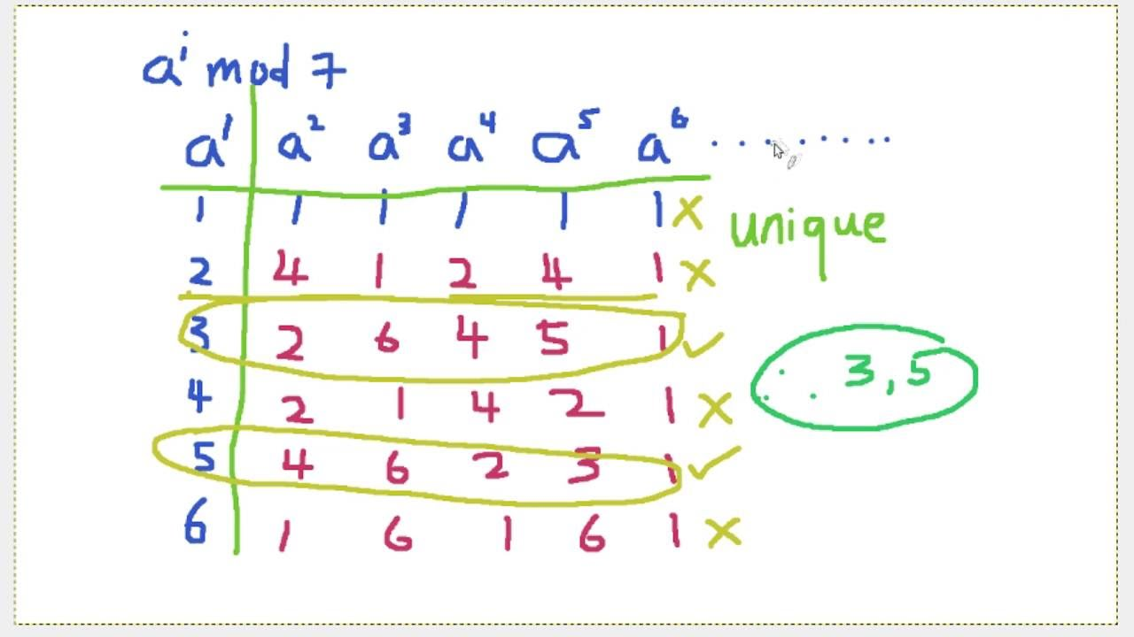
Primitive Root

Slide 16
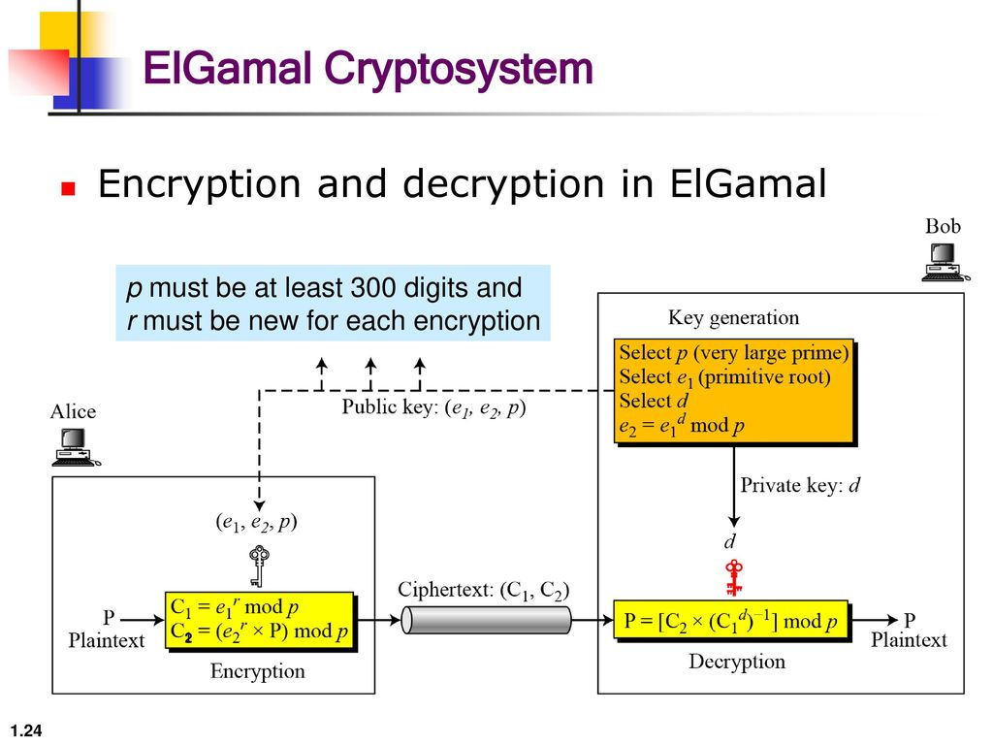

Slide 17
Example
Key Generation
Select P=19
Primitive root e₁=10
Secret key d=5
e₂=e₁^{d} mod P=10⁵ mod 19=3
Encryption
Select r=6
C₁= e₁^{r} mod P
C₁=10⁶ mod 19=11
C2=(e₂^{r} *M) mod P
C₂=(3⁶ *17)mod 19=5
Send(C_{1,} C₂)=(11,5)
Decryption
M=[5*(11⁵)⁻¹] mod 19=17

Slide 18
Example
Key Generation
Select P=23
Primitive root e₁=7
Secret key d=9
e₂=e₁^{d} mod P=7⁹ mod 23=15
Encryption
Select r=3
C₁= e₁^{r} mod P
C₁=7³ mod 23=21
C2=(e₂^{r} *M) mod P
C₂=(15³ *20)mod 23=18
Send(C_{1,} C₂)=(21,18)
Decryption
M= [C2* (C₁^{d})⁻¹]mod P]=[21*(18⁹)⁻¹] mod 23=20

